Slide 1
Real or Not Real?
Try to guess which pictures are real, and which are fake.

Slide 2
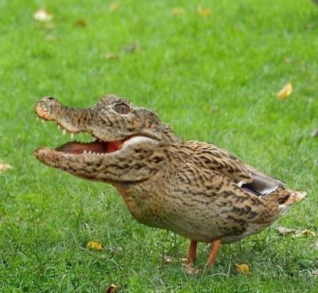
Picture 1: The Crocodile

Slide 3
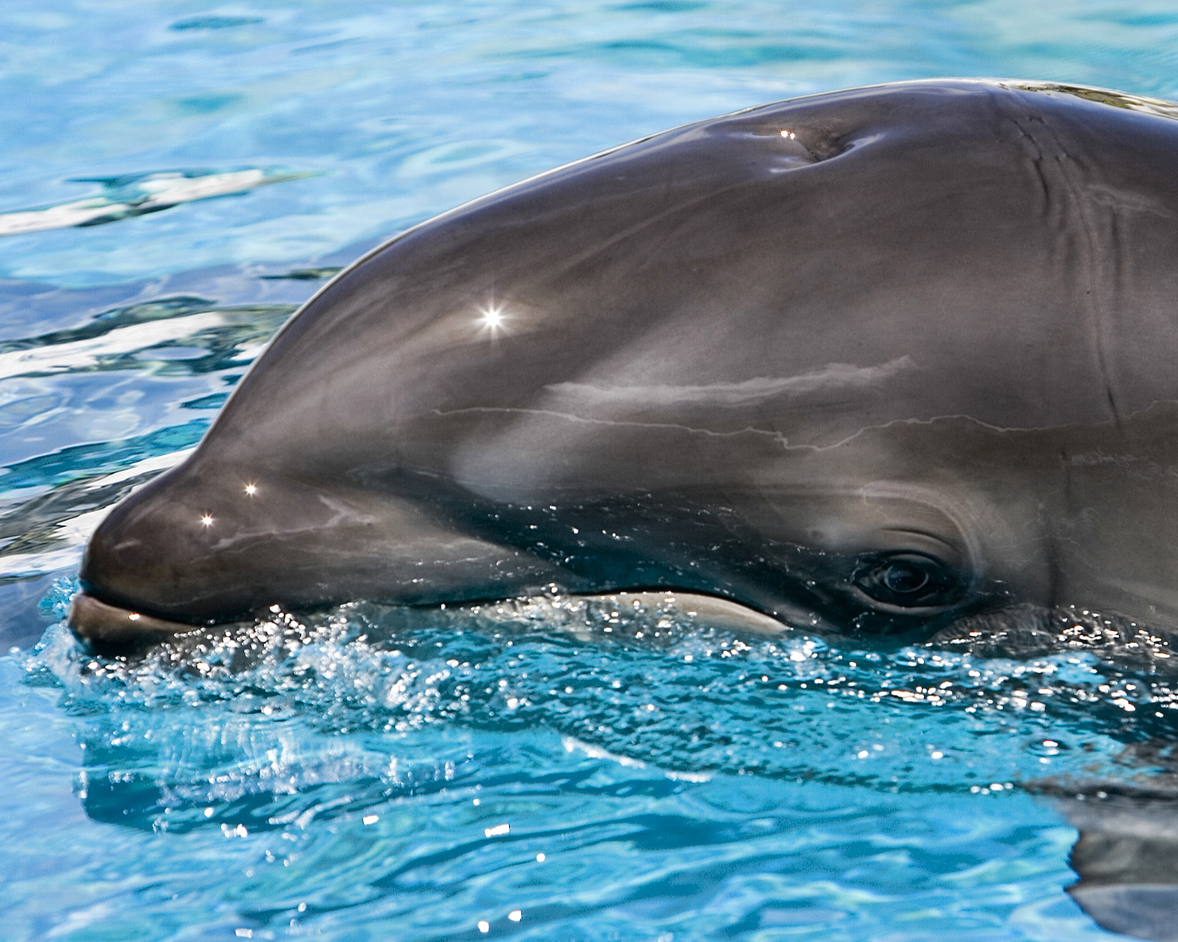
Picture 2: The Wholphin

Slide 4
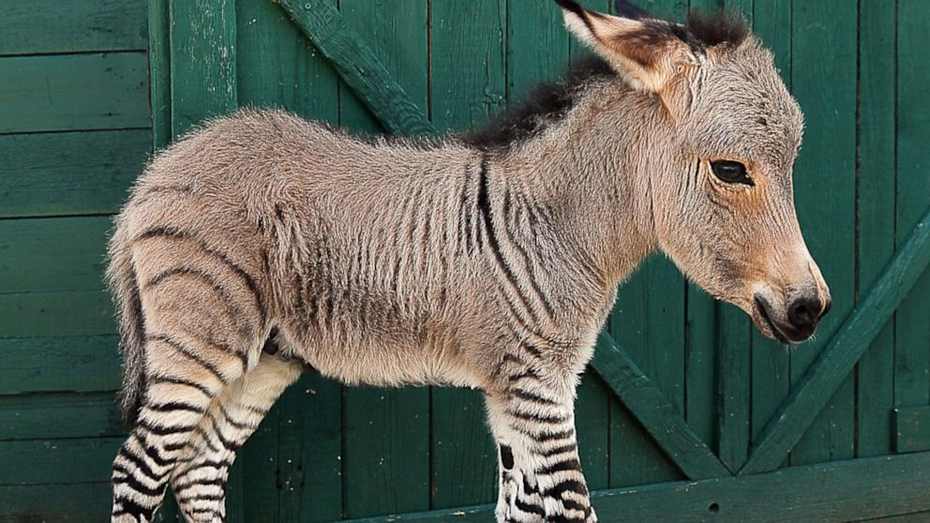
Picture 3: The Zonkey

Slide 5
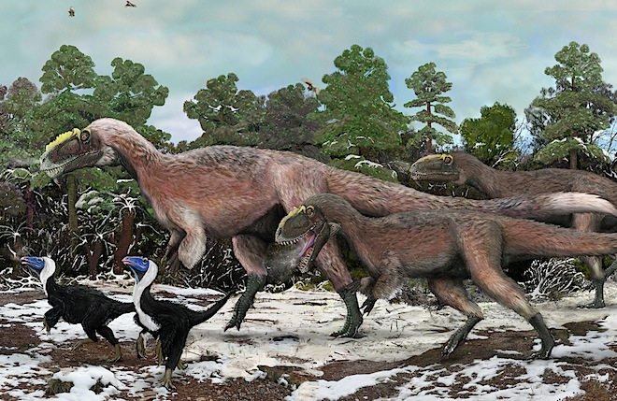
Picture 4: Feathered T-Rex

Slide 6
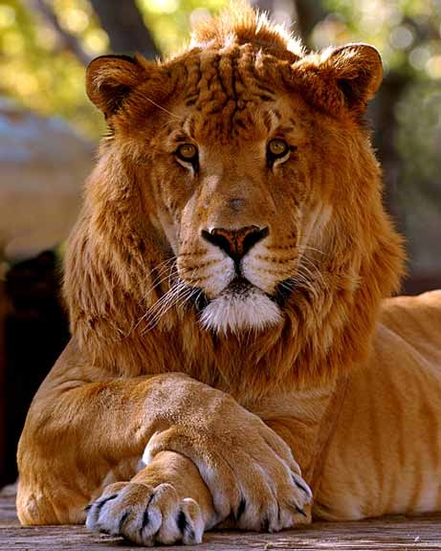
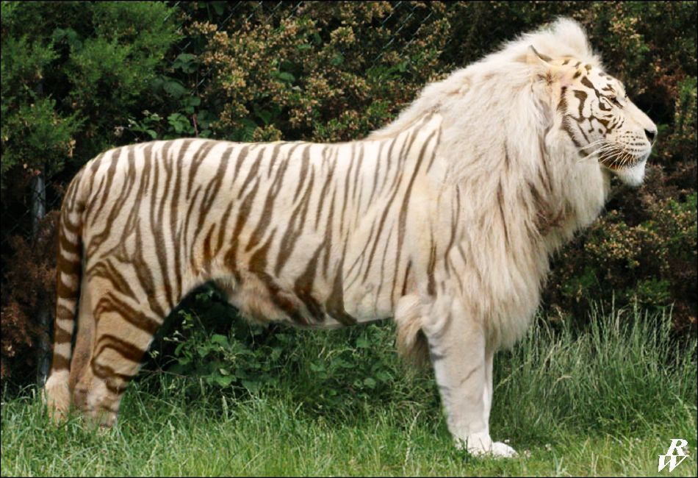
Picture 5: The Tiglon (Liger)

Slide 7
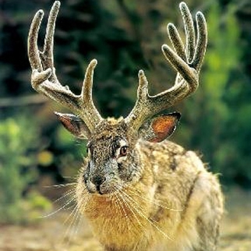
Picture 6: The Jackalope

Slide 8
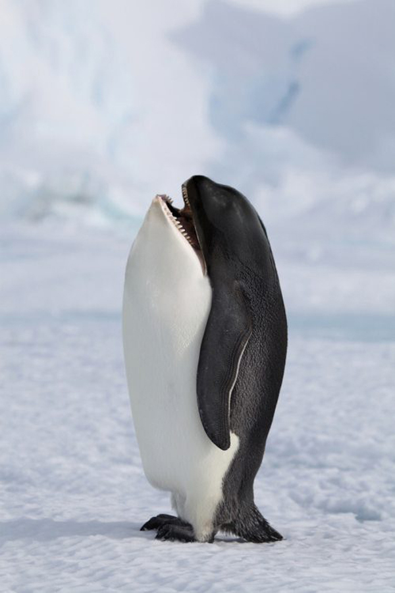
Picture 7: Penwhale

Slide 9
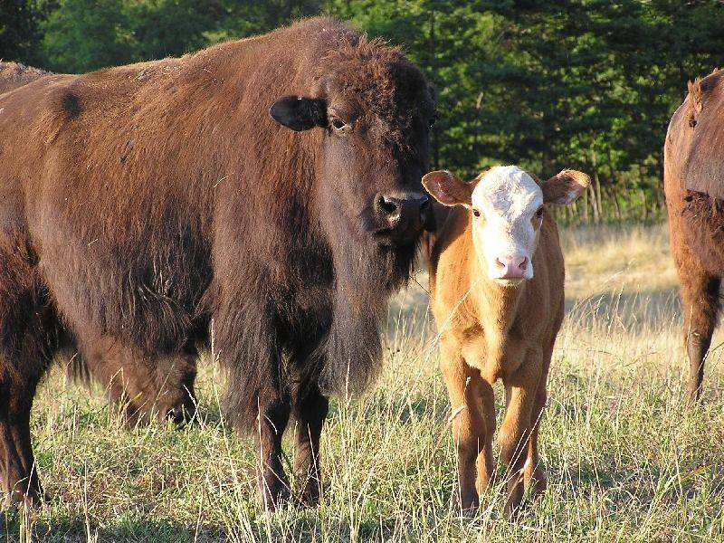
Picture 8: The Beefalo

Slide 10
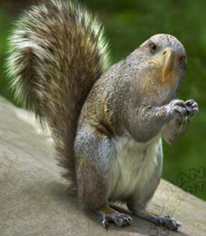
Picture 9: Squirgle

Slide 11
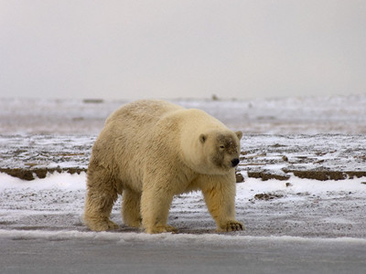
Picture 10: Grolar Bear

Slide 12
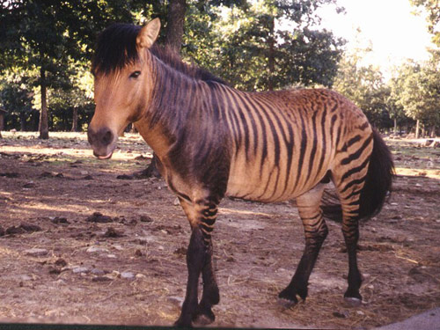
Picture 11: The Zorse

Slide 13
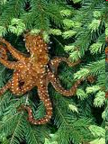
Picture 12: The North American Tree Octopus

Slide 14
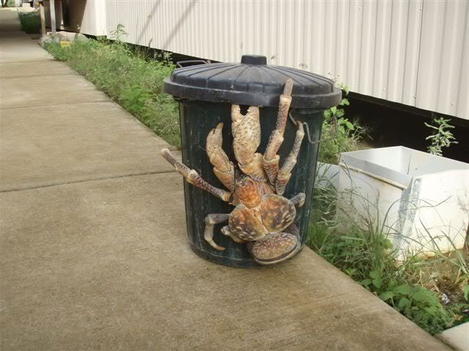
Picture 13: Giant Crab

Slide 15
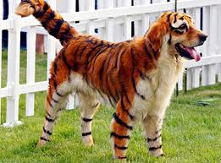
Picture 14: The Tigog

Slide 16
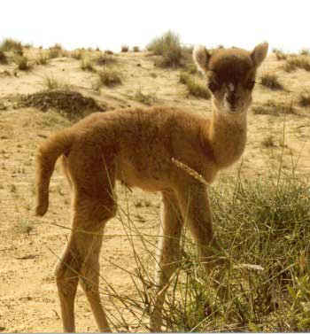
Picture 15: The Cama

Slide 17
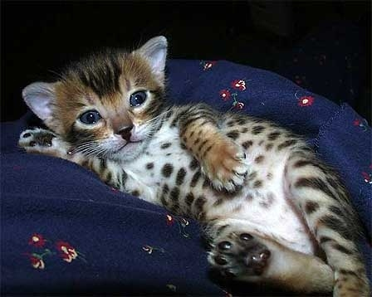
Picture 16: Cheetoh

